Slide 1
Protein Dynamics and Stability: Universality vs. Specificity Rony Granek The Stella and Avram Goren-Goldstein Department of Biotechnology Engineering, Ben-Gurion University of The Negev, Beer Sheva 84105, Israel
Tel-Aviv University Ben-Gurion University
Joseph Klafter RG
Shlomi Reuveni Marina de Leeuw
Roee Ben-Halevi
Amit Srivastava

Slide 2
Natural Proteins
Long sequence of amino acids (20 types).
Thousands of different proteins.
Differ by sequence and length.
Fold in different ways to give different 3-D fold structure.
Conflicting requirements:
Specific folding – leads to a specific function (lock and key…).
Large internal motion is needed to allow for biochemical function (enzymatic activity, antibody function, capturing and releasing ions, etc.).
Problem –
a folded protein has less internal motion than an unfolded
Protein.

Slide 3
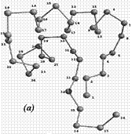
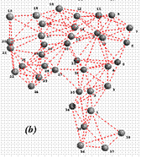
PROTEIN VIBRATIONS: The Gaussian Network Model (GNM)
Scalar elasticity.
Springs exist only below a cutoff distance Rc.
All springs have equal spring constant.
I. Bahar and coworkers

Slide 4
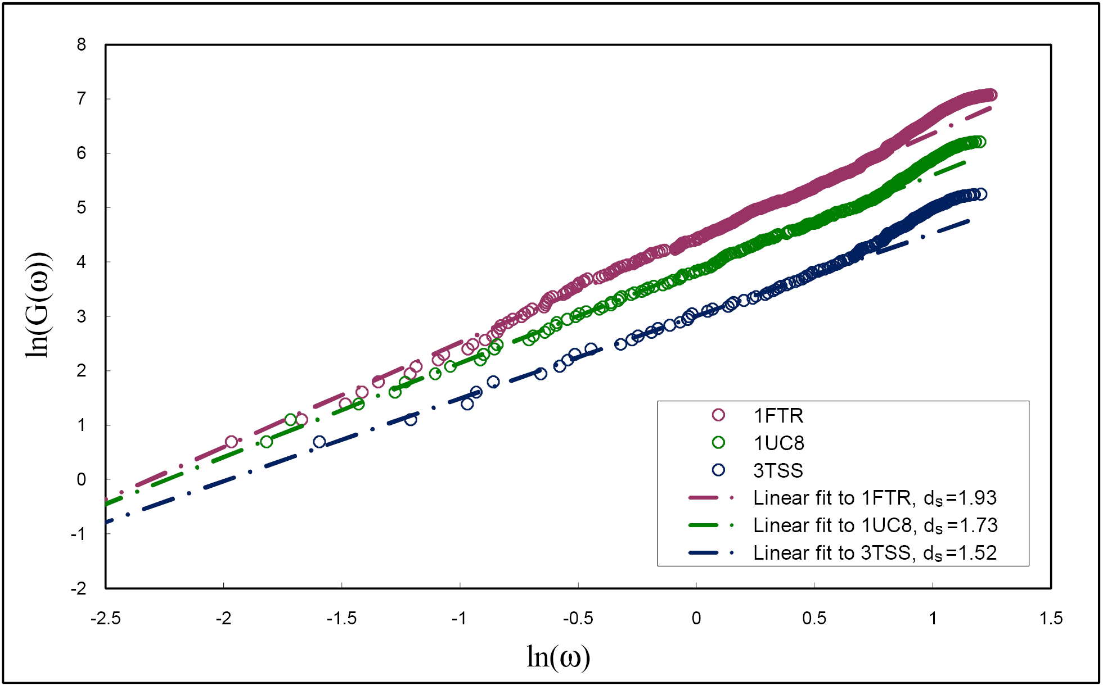
Calculation of cumulated Density of States using the GNM
- Spectral dimension
Are proteins fractal-like?
M. de Leeuw et al., PLOS-ONE (2009); Reuveni et al., PRL (2007)

Slide 5
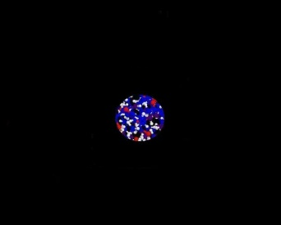
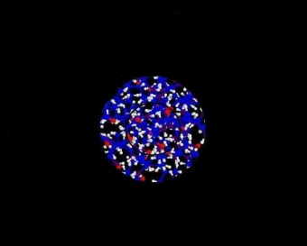
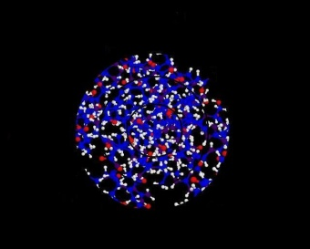
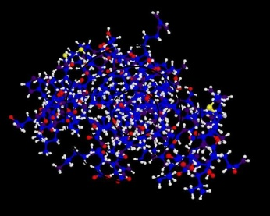
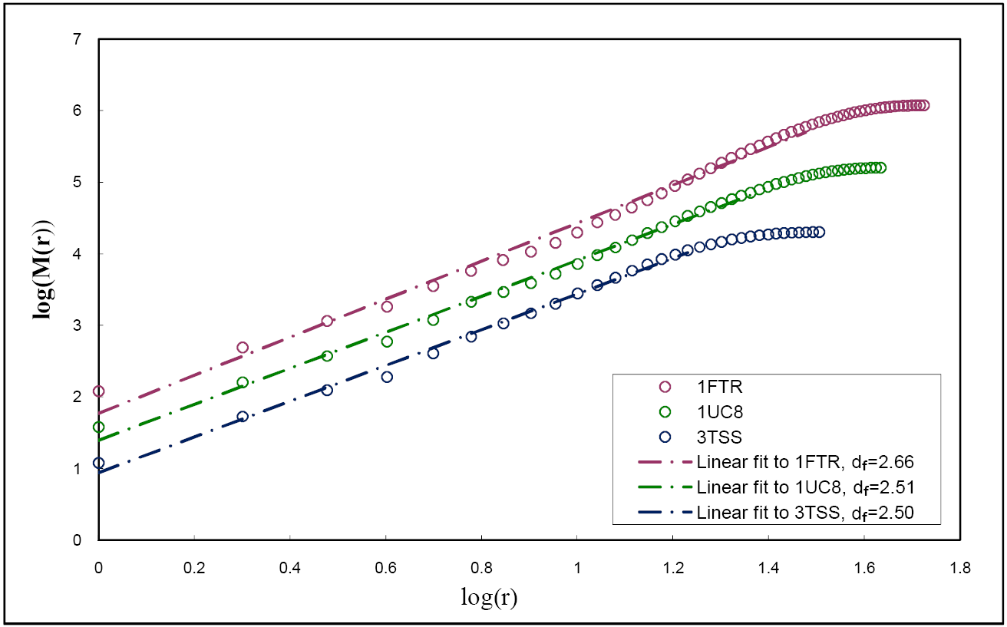
Fractal nature of proteins?
Mass fractal dimension :
The atoms enclosed in spheres of different radii (pdb: 1OCP )
D. M. Leitner
and coworkers
M. de Leeuw et al., PLOS-ONE (2009); Reuveni et al., PRL (2007)

Slide 6
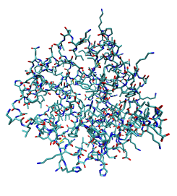
Modeling a Protein as a Fractal – A Step Towards Universality
Replace with an abstract
representation of a protein

Slide 7
Protein Stability & Unfolding
– Amplitude of a normal mode
Equipartition
Thermal fluctuations of the displacements ( )
Landau-Peierls Instability
– # of amino acids (“polymer index”)
If , increases with increasing !
Large fluctuations may assist enzymatic/biological activity.

Slide 8
But should not exceed the mean inter-amino acid distance,
otherwise protein must unfold (or not fold).
Marginal stability. To have large amplitude motion but remain folded:
Proteins can “live” in the “twilight” zone: Folded-Unfolded !
To keep proteins folded, should depend on :
should approach the value of 2 for large proteins.

Slide 9
Instability threshold: Universal relation between exponents
Cluster melting analog:
Unfolding/Melting occurs from the surface inward
Reuveni et al., PRL (2007)

Slide 10
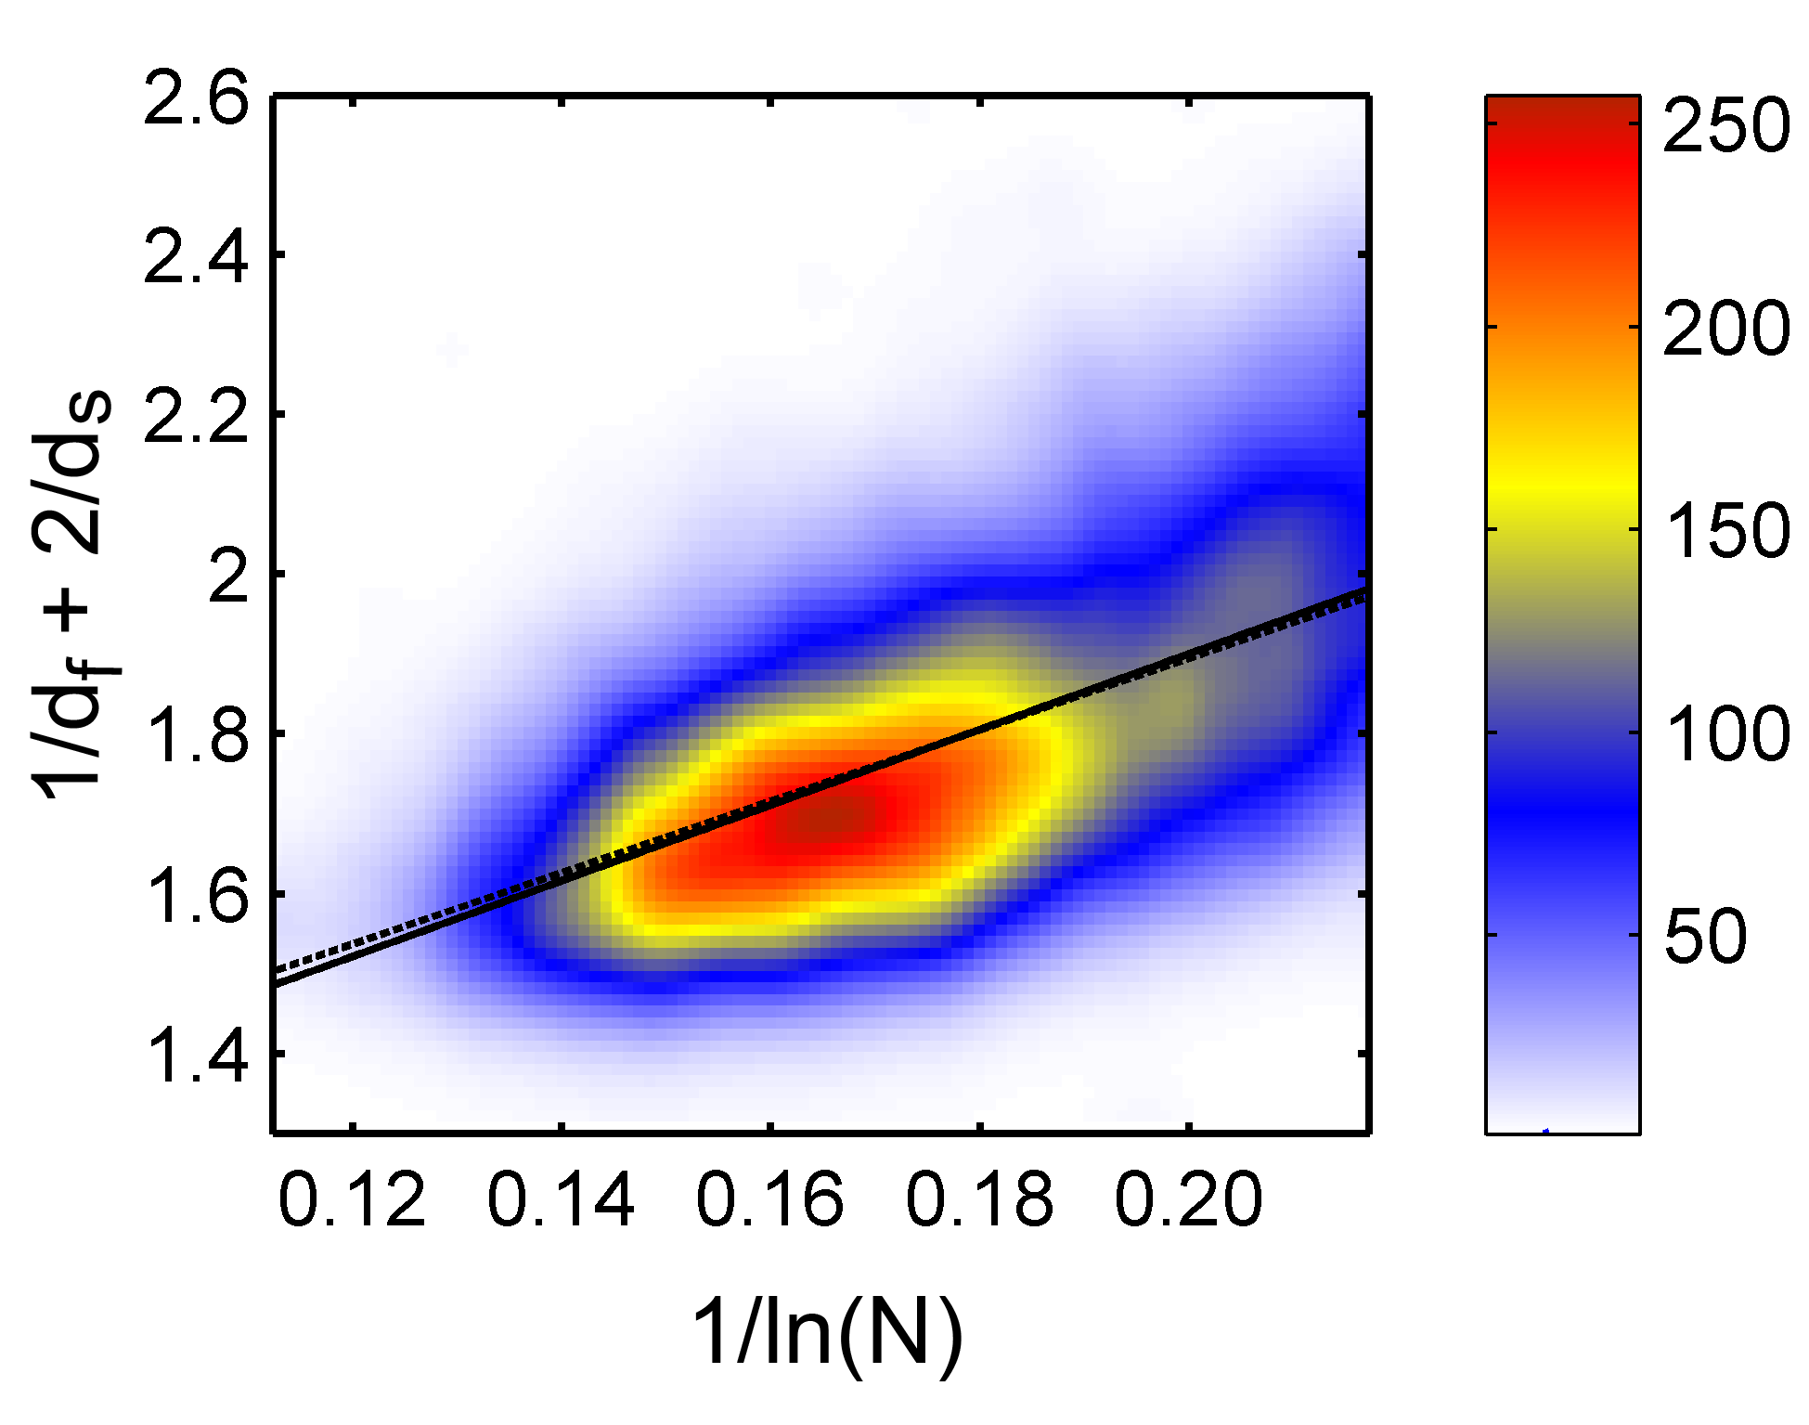
4249 proteins
Colored histogram (100X100 bins)
fit to
a=0.95
cc=0.58
fit to
M. de Leeuw et al., PLOS-ONE, 2009

Slide 11
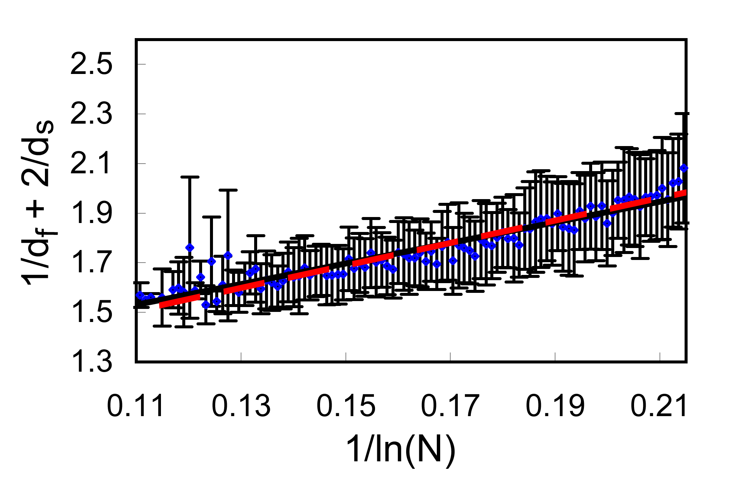
4249 proteins
X-axis separated into 100 bins
fit to
a=1.065
cc=0.945
fit to
M. de Leeuw et al., PLOS-ONE, 2009

Slide 12
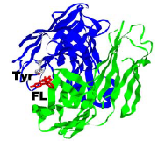
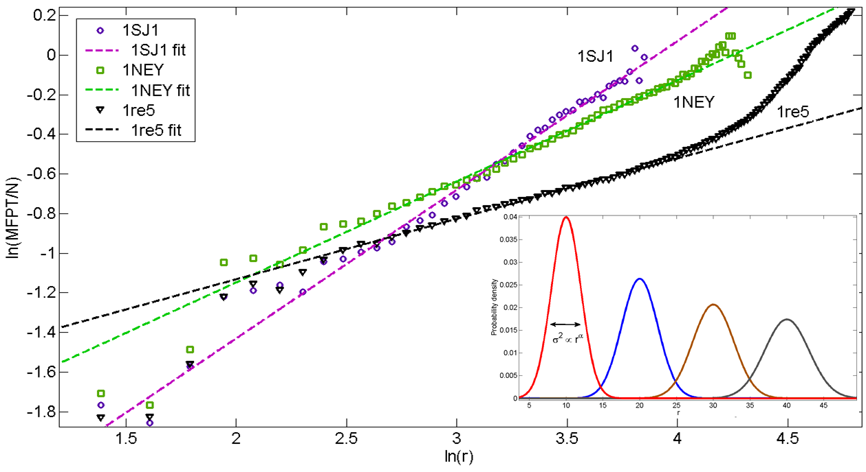
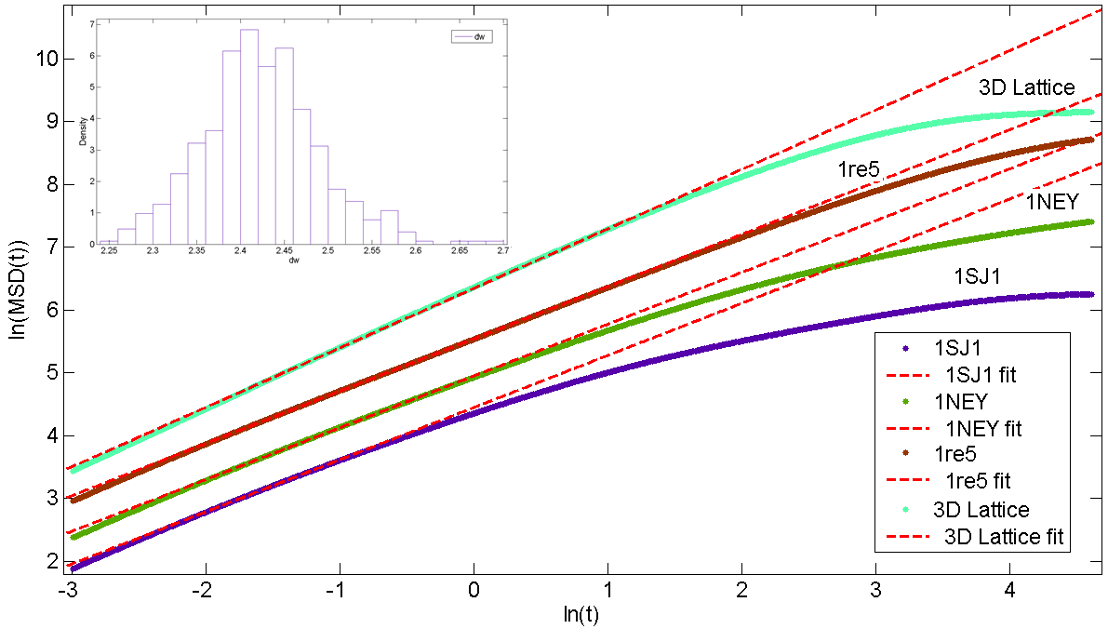
Dynamics
Photo-induced electron transfer,
single molecule experiments,
Xie and coworkers
Fluctuations in distance between two amino acids
Static variance
Propagation length
Granek & Klafter, PRL (2005)
Reuveni et al., PNAS (2010)

Slide 13
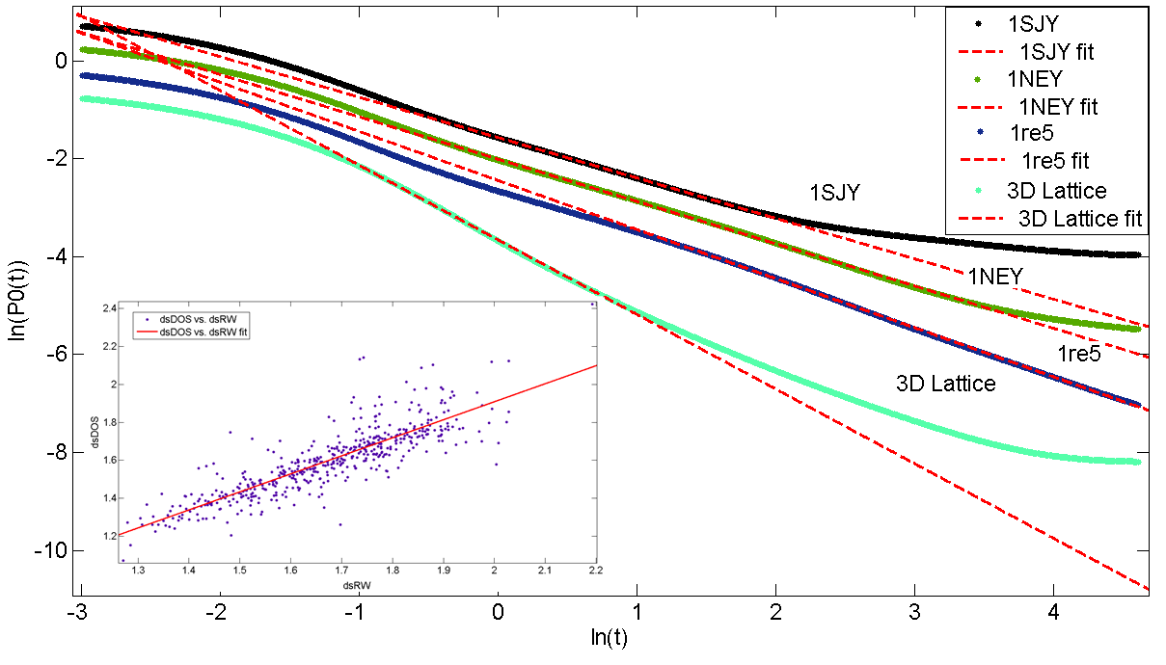
Random walk probability of return to the origin on the same network
Vibrational mean square displacement
Reuveni et al., PNAS (2010)
Conclusions:
Novel approach for vibrations in folded proteins based on their fractal nature → Provides a description on a universal level.
Folded proteins are marginally stable: they exist in a thermodynamic state close to unfolding, which allows for large scale motion without unfolding.
The above criterion leads to a universal “equation of state”, verified for about 5,000 proteins.
The fractal-like properties of proteins lead to anomalous dynamics/ strange kinetics:
autocorrelation of separation; vibrational MSD; random walk MSD, return probability & mean first passage time, dynamic structure factor.

