Slide 1
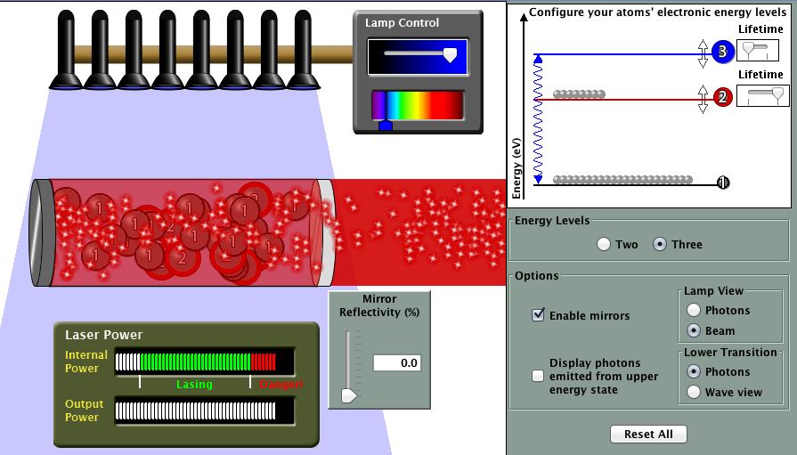


Active Learning & Quantum Simulations in the Classroom
KITP Conference, Santa Barbara
March 2, 2013
Charles Baily
Department of Physics
University of Colorado Boulder
baily@colorado.edu
per.colorado.edu/baily

Slide 2









PER.Colorado.EDU
Faculty:
  Melissa Dancy
  Michael Dubson
  Noah Finkelstein
  Valerie Otero
  Kathy Perkins
  Steven Pollock
  Carl Wieman (on leave)
Postdocs/ Scientists:
  Charles Baily
  Danny Caballero
  Stephanie Chasteen
  Julia Chamberlain
  Katie Hinko
  Kelly Lancaster
  Emily Moore
  Ariel Paul
  Rachel Pepper
  Noah Podolefsky
  Benjamin Zwickl
Grad Students:
  Stephanie Barr
  Kara Gray
  May Lee
  Mike Ross
  Ben Spike
  Ben Van Dusen
  Bethany Wilcox
Teachers / Partners / Staff:
  Shelly Belleau
  Jackie Elser
  Trish Loeblein
  Susan Nicholson-Dykstra
  Sara Severence
  Emily Quinty
  Mindy Gratny, Kate Kidder
  John Blanco, Sam Reid
  Chris Malley, Jon Olson
  Oliver Nix, Nina Zabolotnaya

Slide 3
How important is education?
In March 2001, the U.S. Commission on National Security/21st Century …. on which I served warned that the crisis in scientific research and education is the second greatest threat facing American national security. In fact, the 14 bipartisan members unanimously agreed that the ‘inadequacies of our systems of research and education pose a greater threat to U.S. national security over the next quarter century than any potential conventional war that we might imagine.’ The Commission went on to assert that only a nuclear or biological weapon released in an American city [is] a greater threat
-Newt Gingrich, AEI
Open letter to Congress, May 2005

Slide 4
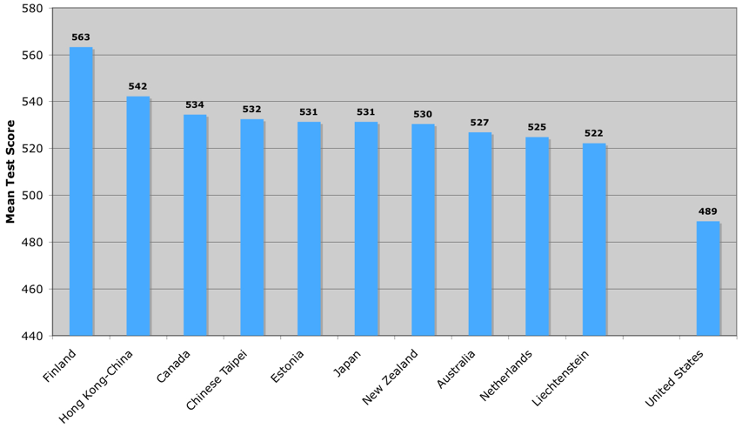
A Crisis in US Education
U.S. ranks:
21 out of 30 in science
25 out of 30 in math
- PISA 2006
International Rankings (science)

Slide 5
A Crisis in US Education
U.S. ranks:
24 out of 30 in science
31 out of 30 in math ;-)
- PISA 2009

Slide 6
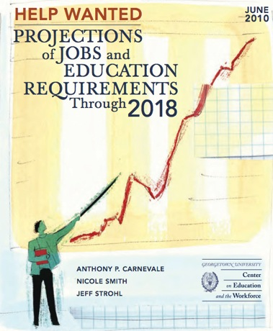
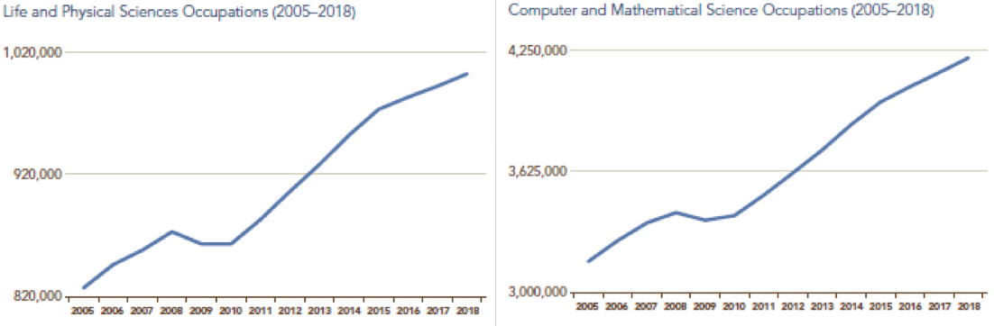
Challenges in US Education
1 Million more STEM grads
needed over the next decade
100,000 more STEM educators

Slide 7
APS/AAPT Doubling Initiative
Mission Statement (2007)
We advocate doubling the number of bachelor degrees
in physics to address critical national needs including
K-12 education, economic competitiveness, energy, security, and an informed electorate.
How might this happen?
- Better preparation
- Retention

Slide 8
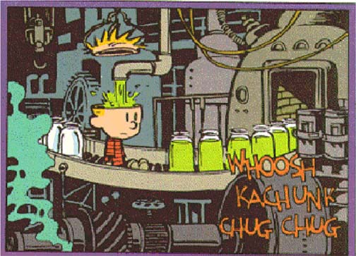
Traditional Model of Education
Content
Instruction via
transmission
Individual

Slide 9
A Wakeup Call
Force Concept Inventory*
Multiple choice survey (pre/post)
Experts (especially skeptics!)
A necessary (not sufficient) indicator of
conceptual understanding.
* Hestenes, Wells, Swackhamer, Physics Teacher 20, (92) 141, 1992

Slide 10
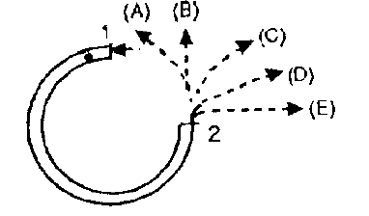
Sample question
Looking down at a track (flat on table), a ball enters at point 1 and exits at point 2. Which path does it follow as it exits (neglect all friction)?

Slide 11
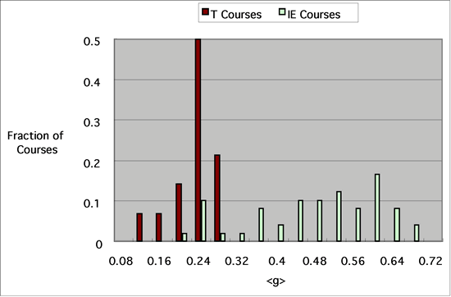
Force Concept Inventory
red = traditional
Take home message:
Students learn less than 25% of the most basic concepts (that they don’t already know).
Less Learning More Learning
R. Hake, ”…A six-thousand-student survey…” AJP 66, 64-74 (1998).

Slide 12
Force Concept Inventory
red = traditional, blue = interactive engagement
Less Learning More Learning
R. Hake, ”…A six-thousand-student survey…” AJP 66, 64-74 (1998).

Slide 13
Force Concept Inventory
red = traditional, blue = interactive engagement
CU – IE w/
trad. recitations
CU - IE w/
Tutorials
Less Learning More Learning
R. Hake, ”…A six-thousand-student survey…” AJP 66, 64-74 (1998).
S. Pollock and N. Finkelstein, PRST-PER 4, 010110 (2008)

Slide 14

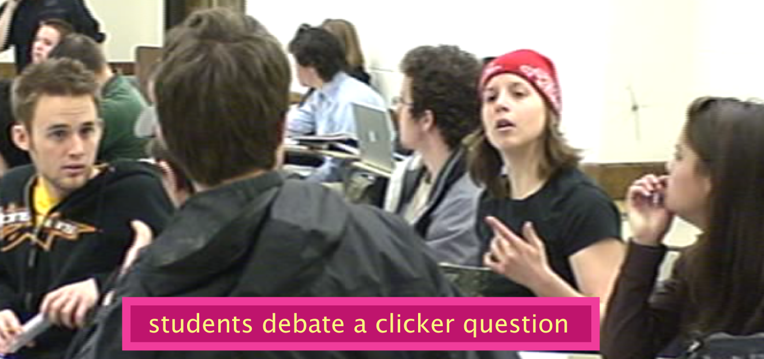
Can high school students learn more from interactive techniques adapted from university physics courses?
Typical Classroom (?)
?
Students debate a concept test

Slide 15
Overview
Transforming the classroom
  Concept tests/Peer instruction
  In-class activities/tutorials
Quantum Simulations
  Lasers (!!)
  Matter waves
Quantum Interpretations

Slide 16
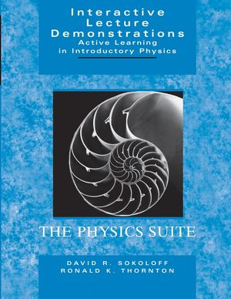
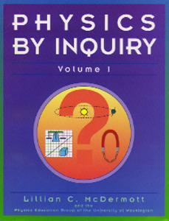
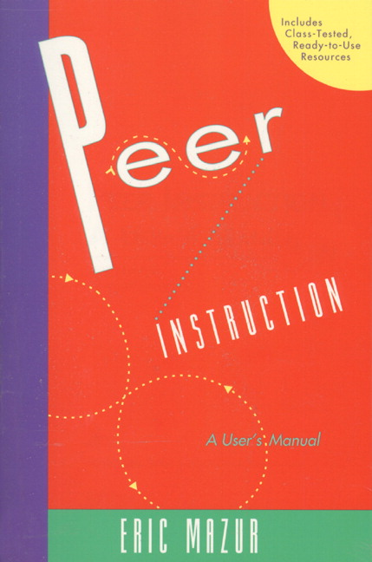
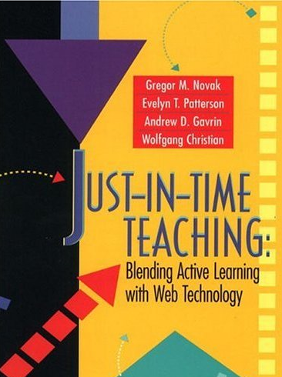
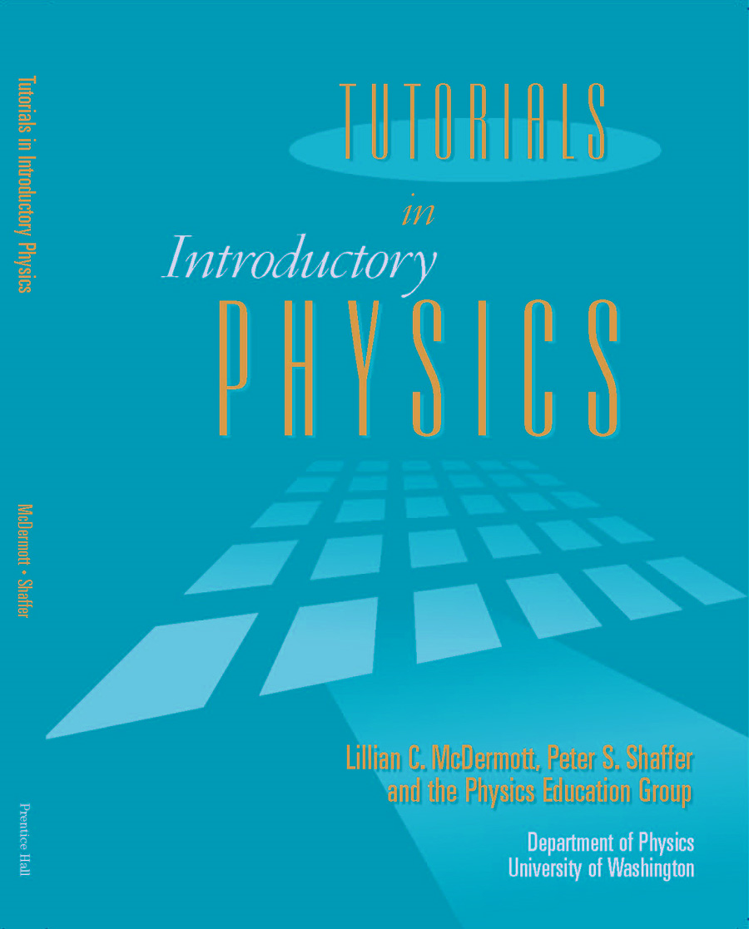
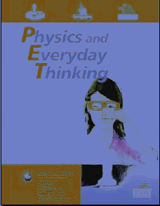
Many PER curricular innovations
Notes:
16

Slide 17
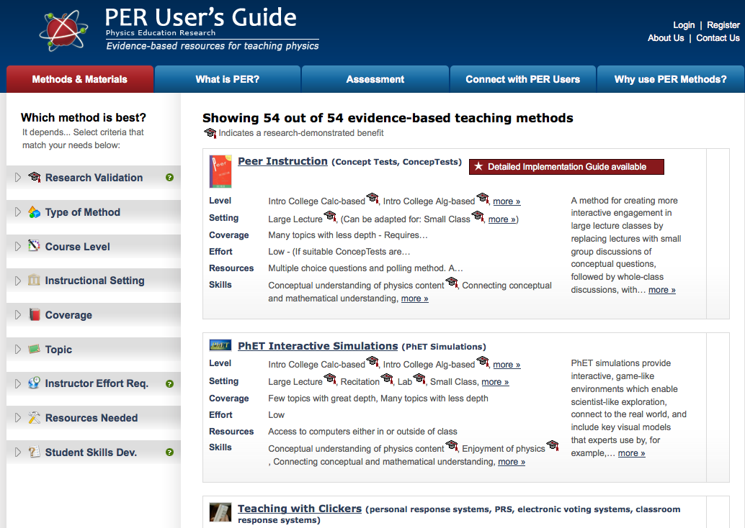

Slide 18
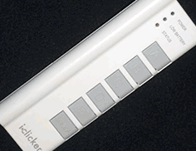
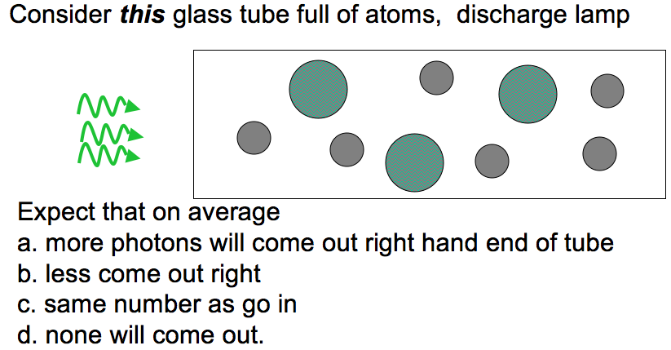

Concept Tests

Slide 19
Arguments against using concept tests
Eats up time
Important ideas can be complex
Discussion easy in small classes
We/they don’t always know they need to ask questions
Students may resist
But perhaps only initially…
Extra effort for teachers
Question banks available if you want to try!

Slide 20
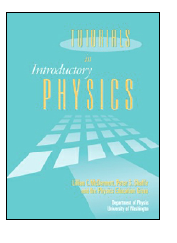
Tutorials in Introductory Physics
Reconceptualize Classroom Learning
  Materials
  Classroom format / interaction
  Instructional Role

Slide 21
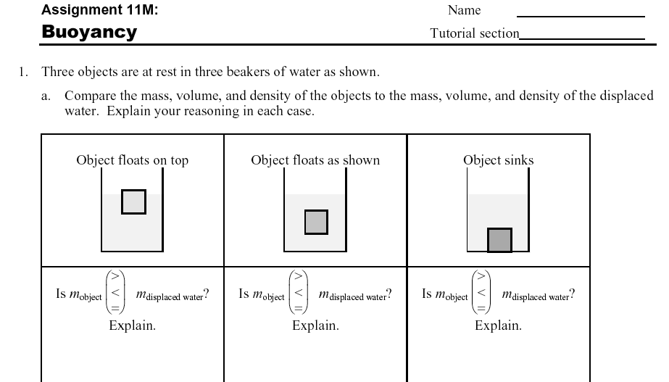
Tutorial Materials
Hands-on, Inquiry-based, Guided, Research-based

Slide 22
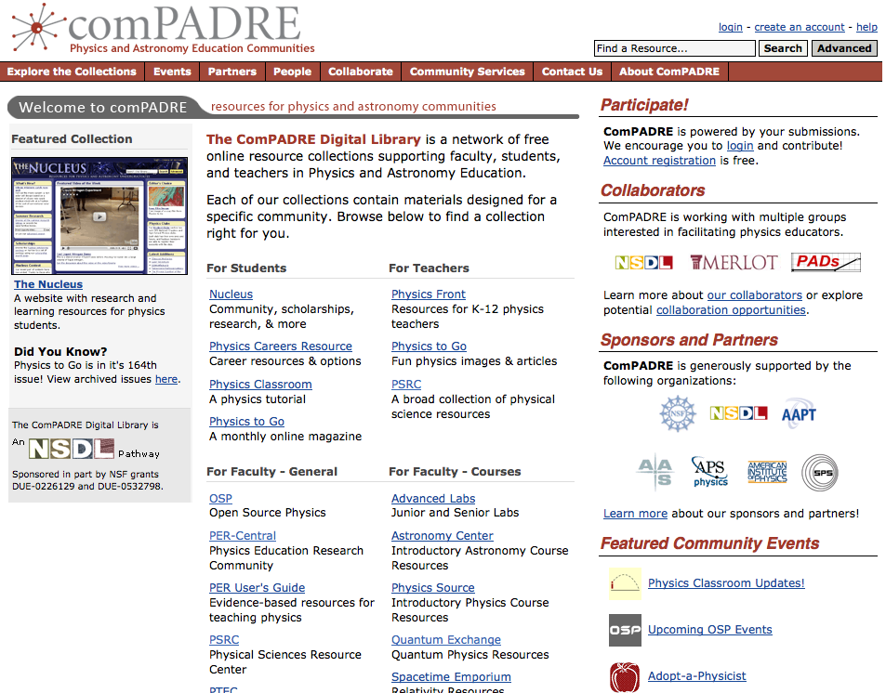

Slide 23
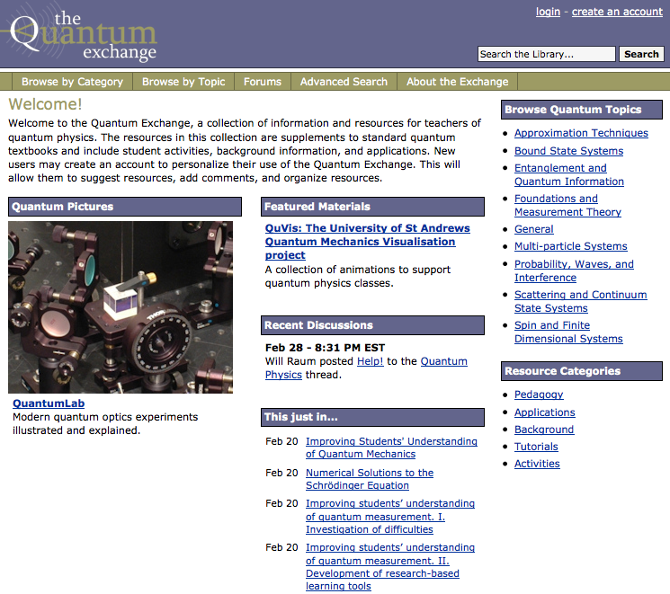

Slide 24
Trad’l Classroom vs. Tutorials
Trad'l Classroom vs Tutorial

Slide 25
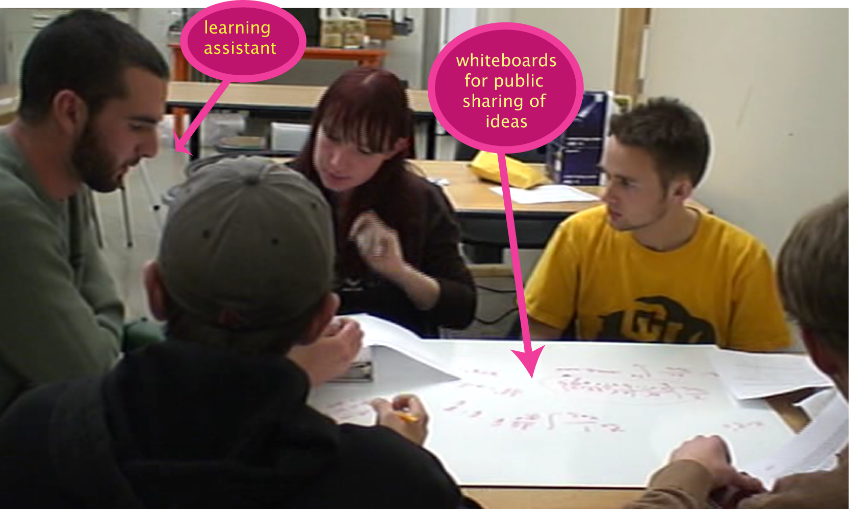
Socratic Dialogue

Slide 26
Impact on different pretest populations:
"low starters" pretest <=12.5%
0.5
0.4
0.3
0.2
0.1
<g>
Tutorial
(23%)
Traditional
(22%)
(% of class in this pool)
S. Pollock, 2005 PERC proceedings
Notes:
26

Slide 27
Impact on different pretest populations:
"high starters" 50<pre<93%
0.9
0.7
0.5
0.3
0.1
<g>
Tutorial
(13%)
Traditional
(14%)
(% of class in this pool)
S. Pollock, 2005 PERC proceedings
Notes:
27

Slide 28
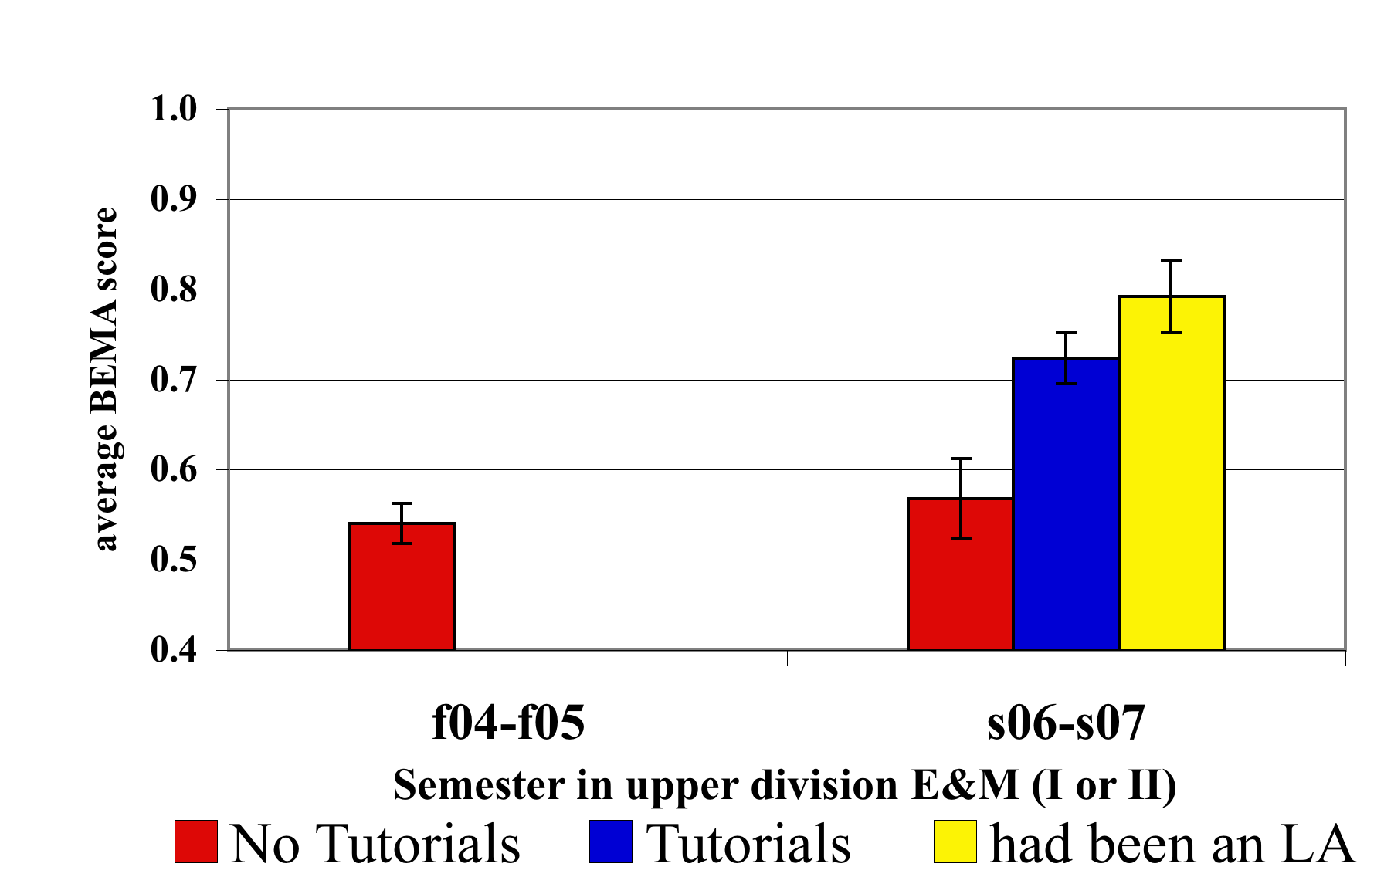
Long Term Impacts
Upper-Division Physics Majors – BEMA Scores
Grade in course
(3.3 ±.1)
(3.1 ±.1)
(3.0 ±.1)
F04-F05
S06-S07
Semester in upper-division E&M (I or II)
No Tutorials
Tutorials
Post-Instruction – Only students with no tutorials in intro E&M
Had intro E&M with Tutorials
S. Pollock, PRST-PER 5, 020101 (2009)

Slide 29
It’s not about our teaching, it’s about creating environments that support student learning

Slide 30
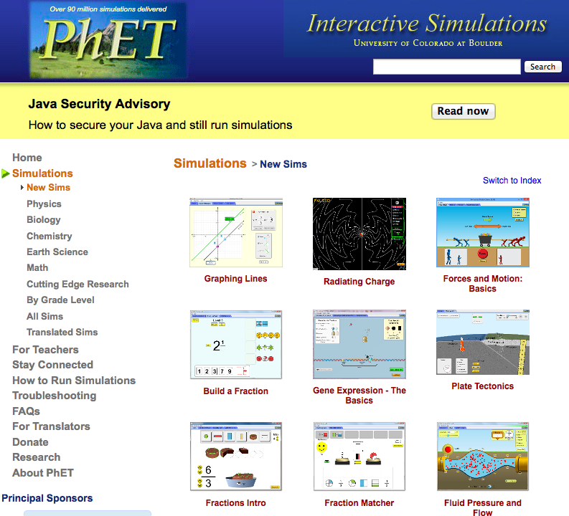
http://phet.colorado.edu

Slide 31
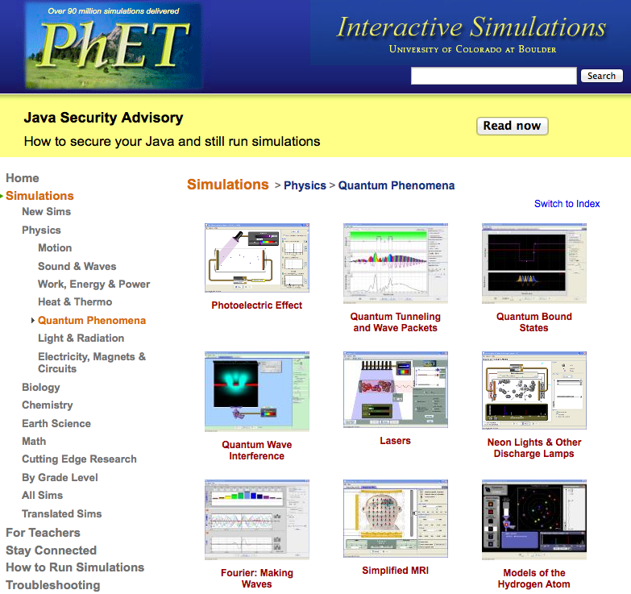
http://phet.colorado.edu

Slide 32
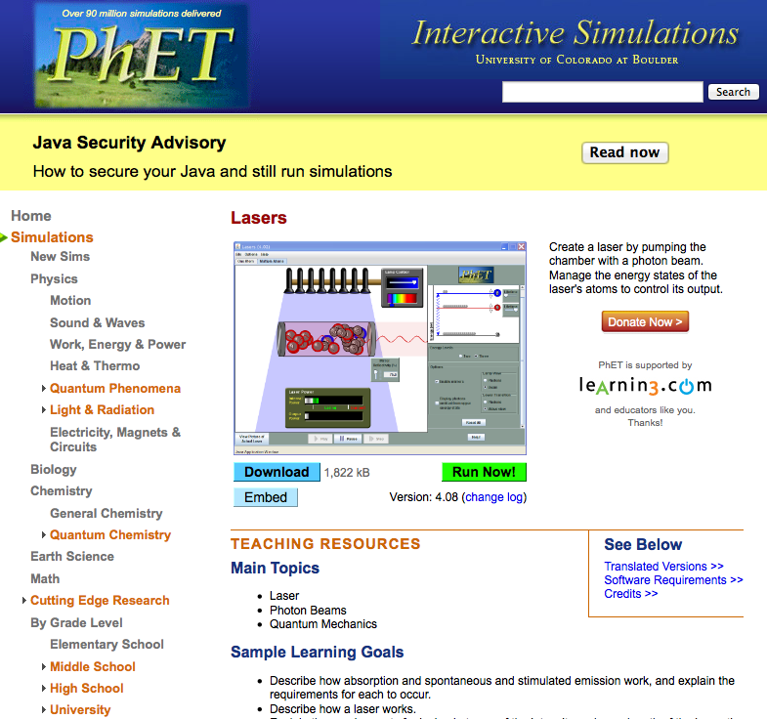
http://phet.colorado.edu

Slide 33
Modern Physics for Engineers
“I think quantum mechanics is an interesting subject."
Pre-Instruction Average
Post-Instruction Average
Post-Instruction
ENG-INT

Slide 34
New Modern Physics Curriculum
Expose students to ideas regarding interpretive themes from the historical development of QM.
  Complementarity/wave-particle duality
  Wave function collapse
  Entanglement/non-locality
Present canonical experiments on foundations of QM.
  Single-quanta experiments
  Distant, correlated measurements
Introduce contemporary topics in quantum information theory.
  Computing, cryptography, etc…

Slide 35
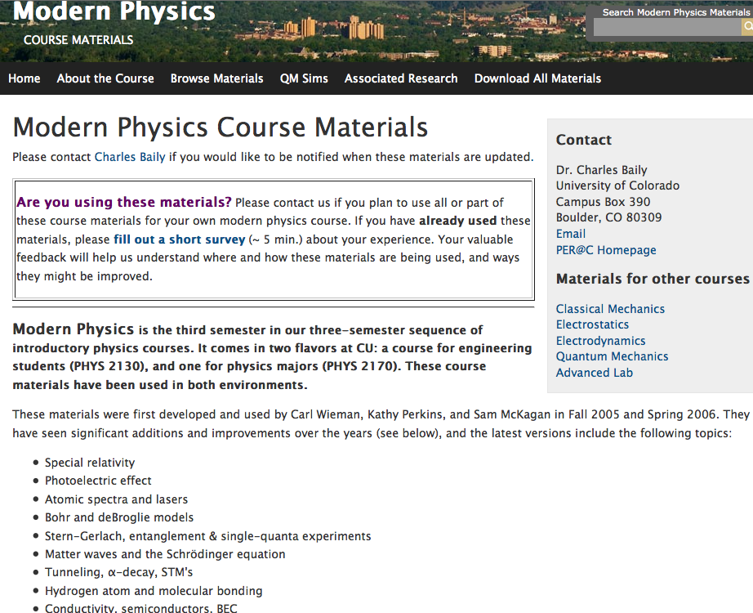

Slide 36
Modern Physics for Engineers
“I think quantum mechanics is an interesting subject."
Pre-Instruction Average
Post-Instruction Average
Post-Instruction
ENG-INT

Slide 37
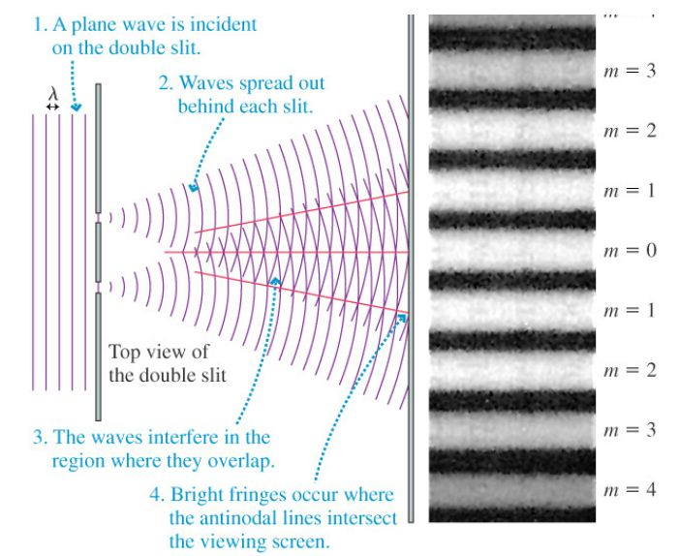
Double-Slit Experiment
(photons or electrons)

Slide 38

Double-Slit Experiment with Single Electrons (1989)
http://www.hitachi.com/rd/portal/research/em/doubleslit.html
A. Tonomura, J. Endo, T. Matsuda, T. Kawasaki and H. Ezawa,
"Demonstration of Single-Electron Buildup of an Interference Pattern,“
Amer. J. Phys. 57 (1989) pp.117-120.
.

Slide 39
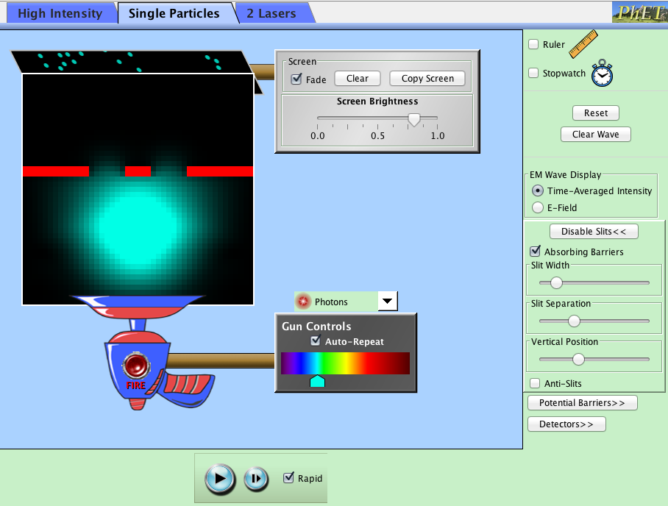

Slide 40
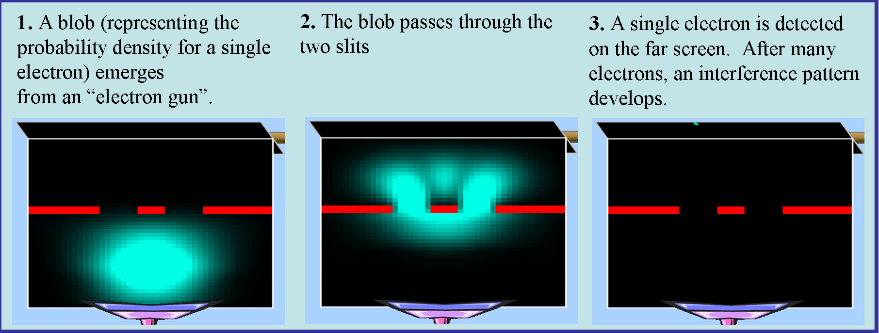
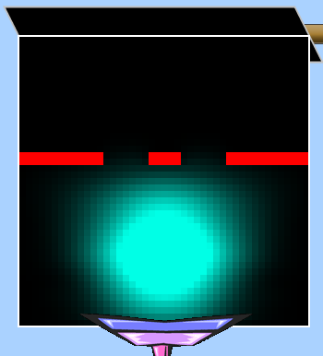
[Realist] Each electron is a tiny particle that went through one slit or the other.
[Matter-Wave] Each electron went through both slits and interfered with itself.
[Agnostic] We can’t say what the electron is doing between being emitted and detected.

Slide 41
Double-Slit Interpretation
Realist
Agnostic
Matter-Wave
ENG-R/S
ENG-MW
PHYS - C/A
ENG-INT

Slide 42
”When not being observed, an electron in an atom
exists at a definite but unknown position
at each moment in time."
ENG-R/S
ENG-MW
PHYS - C/A
ENG-INT

Slide 43
"The probabilistic nature of quantum mechanics is mostly due
to the limitations of our measurement instruments."
Post-Instruction
ENG-R/S
ENG-MW
PHYS - C/A
ENG-INT

Slide 44
“I think quantum mechanics is an interesting subject."
ENG-R/S
ENG-MW
PHYS - C/A
ENG-INT

Slide 45
Student Reflections
“I entered Physics 3 with a bitter taste in my mouth.
Yet, some fragment of my mangled ego compelled me to continue down the path I was on. I have always found physics to be the most intriguing subject, and I was not about to let one class ruin it. I approached Physics 3 as the deal breaker: if this class was like its predecessor, then maybe mechanical engineering was a more apt major. […] Throughout the course, the almost magical results quantum mechanics attained reassured me that I am in the correct major. The teaching style in conjunction with the material made quantum physics attainable. I am not sure if it was the teaching that rejuvenated my passion or the material itself; either way I welcomed back my old friend, physics, with open arms and anticipation.”

Slide 46

Questions?
Much more at:
per.colorado.edu/cts
per.colorado.edu/ModernPhysics
stemclickers.colorado.edu
phet.colorado.edu
perusersguide.org
www.compadre.org/quantum
www.falstad.com/mathphysics.html
Notes:
46

